Slide 1


OpenShift Sharks
OpenShift Networking

Slide 2

oc get content
OPENSHIFT NETWORKING | Architecture design
External Load Balancer
OpenShift SDN
Routes and Ingress
KubernetesOVN
Alternatives for ingress
Multus
Cluster DNS
DNS & Load Balancing
CNI Echosystem
Metal LB

Slide 3
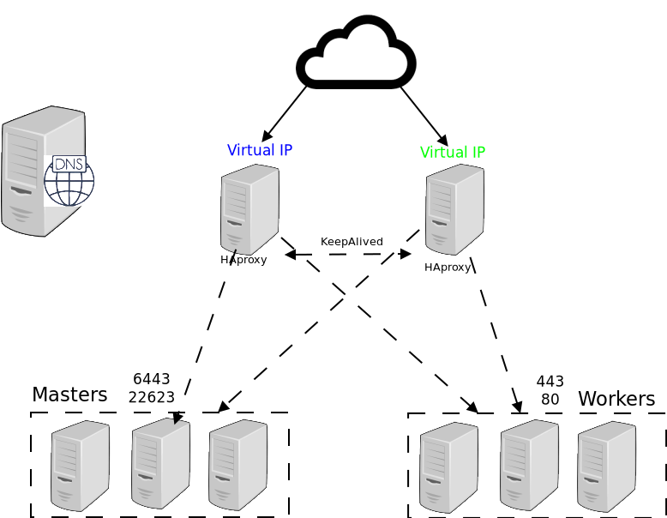
From Top to Bottom
OPENSHIFT NETWORKING | Architecture design

Slide 4
OpenShift External LB
For physical, OSP, RHV, and vSphere IPI deployments

Slide 5



On-prem OpenShift IPI DNS and Load Balancer
OpenShift 4 external load balancing introduced a way of doing load balancing for the api, api-int, DNS, and *.apps (Ingress) endpoints.
This method was originally used by the Kubernetes-native Infrastructure concept when creating bare metal clusters
Excruciating detail: https://github.com/openshift/installer/blob/master/docs/design/baremetal/networking-infrastructure.md

Slide 6




keepalived
Used to ensure that the API and Ingress (*.apps) Virtual IPs (VIP) are always available
Utilizes Virtual Router Redundancy Protocol (VRRP) to determine node health and elect an IP owner
Only one host owns the IP at any time
All nodes have equal priority
Failover can take several seconds
Node health is checked every one second
Separate checks for each service (API, Ingress/*.apps)
ARP is used to associate the VIP with the owner node’s interface
VIP
Active node uses RARP to claim traffic
Health status checks
Active node passes traffic to endpoint

Slide 7

API load balancer
Client creates a new request to api.cluster-name.domain.name
HAProxy on the node actively hosting the API IP address (as determined by keepalived) load balances across control plane nodes using TCP round robin
The connection is forwarded to the chosen control plane node, which responds directly to the client, a.k.a. “direct return”
3
1
2
Control plane nodes
Notes:
Refer to here and here for details on how HAProxy forwards traffic and the path data takes (thanks to Fred Herrmann for details!)

Slide 8

Ingress load balancer
The VIP, managed by Keepalived, will only be hosted on nodes which have a Router instance
Nodes without a Router continue to participate in the VRRP domain, but fail the check script, so are ineligible for hosting the VIP
Traffic destined for the *.apps Ingress VIP will be passed directly to the Router instance
Worker / Infra nodes

Slide 9
Requirements and limitations
Multicast is required for the Keepalived (VRRP) and mDNS configuration used
VRRP needs layer 2 adjacency to function
All control plane nodes must be on the same subnet
All worker nodes capable of hosting a router instance must be on the same subnet
The VIPs must be on the same subnet as the hosts
HAproxy performs NAT for the Clients IP.
Keepalived failover will result in disconnected sessions, e.g. oc logs -f <pod> will terminate
Failover may take several seconds
The HAproxy for the ingress can load balance through TCP or through http
In case of http load balancing the HAproxy can set an X-forwarder-for or a proxy protocol to forward client information to the ingress
Notes:
Here is the trail for #5...
VRRIP IDs are used in the keepalived conf here and here (also applies for other on-prem IPI)
The IDs are generated using the baremetal-runtimecfg utility with this function
The function above uses an implementation of the fletcher checksum based on the cluster name
The result is checked for internal collisions (do the API and ingress IDs match?) but there is no logic to check if there is an existing VRRP instance running with that ID
To check for and prevent VRRP ID collisions, use the command “podman run quay.io/openshift/origin-baremetal-runtimecfg:4.5 vr-ids <cluster name>” for each of the clusters. Note that this is documented here.

Slide 10
Alternatives
“I don’t like this,” “I can’t use this,” and/or “this does not meet my needs”. What other options are there?
Load Balancer
Any load balancer that supports tcp/http load balancing and as TLS passthrough capabilities can replace the external HAproxy + Keepalieved
Ingress
3rd party partners, such as (Community) Haproxy , Nginx, F5 and Organization SDN, have certified Operators that are capable of replacing the Ingress solution as a day 2 operation
API
There is no supported way of replacing the API
DNS
Any external DNS that can holds A + SRV records can be used as a valid DNS server (windows , bind , DJB dns )

Slide 11
routes
and
ingress
How traffic enters the cluster

Slide 12
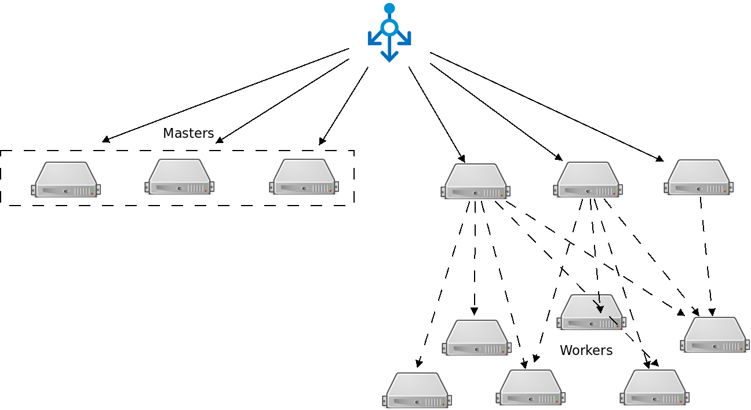
Route distribution (CVR)
OPENSHIFT NETWORKING | Routes and Ingress

Slide 13
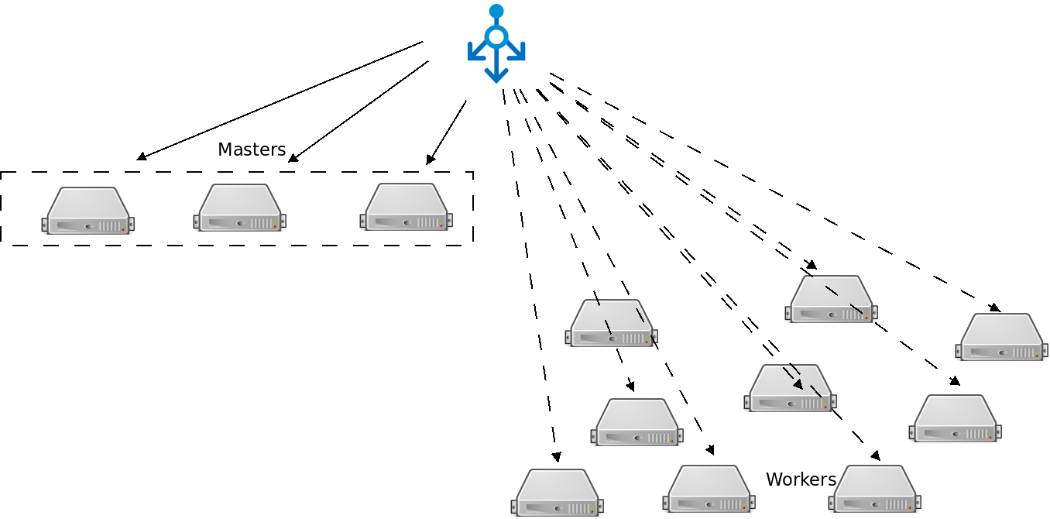
Route distribution (DVR)
OPENSHIFT NETWORKING | Routes and Ingress

Slide 14


Routing and Load Balancing
OPENSHIFT NETWORKING | Routes and Ingress
Pluggable routing architecture
HAProxy Router
F5 Router
Multiple-routers with traffic sharding
Router supported protocols
HTTP/HTTPS
WebSockets
TLS with SNI
Non-standard ports via cloud load-balancers, external IP, and NodePort

Slide 15

Router-based deployment methodologies
OPENSHIFT NETWORKING | Routes and Ingress
Split Traffic Between Multiple Services For A/B Testing, Blue/Green and Canary Deployments
ROUTE
90% traffic
10% traffic
SERVICE A
SERVICE B
App A
App A
App B
App B

Slide 16
Alternative methods for TCP/UDP Traffic
Different ways that traffic can enter the cluster without the router

Slide 17
Entering the cluster on a random port with service nodeports
OPENSHIFT NETWORKING | Alternative methods
NodePort binds a service to a unique port on all the nodes
Traffic received on any node redirects to a node with the running service
Ports in 30K-60K range which usually differs from the service
Firewall rules must allow traffic to all nodes on the specific port
CLIENT
connect 192.10.0.10:31421
192.10.0.11:31421
192.10.0.12:31421
SERVICE
INT IP: 172.1.0.20:90
POD 10.1.0.1:90
POD
10.1.0.2:90
POD
10.1.0.3:90
NODE 192.10.0.10
NODE 192.10.0.11
NODE 192.10.0.12
Notes:
NodePort allow exposing non-standard ports for a service on all nodes in the cluster
If the node receiving the traffic doesn't have the target service running, the traffic is redirected to a node which has the pod running
While it is easier to configure than external IPs and Ingress (prev slide), it is a wasteful use of scarce port resources and it requires more privileges.

Slide 18
External traffic to a service on any port
with external IP
OPENSHIFT NETWORKING | Alternative methods
Access a service with an external IP on with Metal LB any TCP/UDP port, such as
Databases
Message Brokers
Automatic IP allocation from a predefined pool using Ingress IP Self-Service
IP failover pods provide high availability for the IP pool (fully supported in 4.8)
CLIENT
connect 200.1.0.10:90
SERVICE
EXT IP: 200.1.0.10:90
INT IP: 172.1.0.20:90
POD 10.1.0.1:90
POD
10.1.0.2:90
POD
10.1.0.3:90
NODE 192.10.0.10
NODE 192.10.0.11
NODE 192.10.0.12
Notes:
External IP allows assigning an external IP to a service so that client outside of the OpenShift cluster can connect to services inside the Openshift cluster (e.g. database, JMS broker) on that port. This is particularly useful for services that are running on ports other than 80/433, otherwise router is a more suitable alternative. It is also useful when the client needs to know a specific IP for the service in order to open firewalls or while-list it in their own system.
Each external IP address is guaranteed to be assigned to a maximum of one service. This ensures that each service can simply expose its chosen ports regardless of the ports exposed by other services.
The external IP address itself is not managed by the underlying Kubernetes infrastructure and must be maintained and provided by a cluster administrator. Managing external IPs is not convenient since application users cannot create external IP addresses themselves, and must work with cluster administrators to allocate an address for their usage. There is also no protections in place to restrict the usage of a particular external address configured within the cluster.
Ingress IP self-service is a functionality within OpenShift to streamline the allocation of External IP’s for accessing to services in the cluster. Cluster administrators can designate a range of addresses using a CIDR notation which allows an application user to make a request against the cluster for an external IP address. When a service is configured with the type LoadBalancer, an External IP address will be automatically assigned from the designated range.
Ingress is supported for non-cloud clusters. For cloud (GCE, AWS, and OpenStack) clusters, cloud provider’s load balancer service can be used to automatically deploy a load balancer to target the service’s endpoints.
The IP failover pods are responsible for providing the external IP range (Virtual IPs) and would run on one or more of the nodes (more than one for high availability) in the cluster or they can just run on the HAProxy (router) nodes.
The OpenShift cluster administrator must ensure that the external IP address pool terminates at one or more nodes in the cluster.

Slide 19
Cluster DNS
An automated system for providing hostname resolution within kubernetes

Slide 20
CoreDNS
OPENSHIFT NETWORKING | CoreDNS
Built-in internal DNS to reach services by a (fully qualified) hostname
Split DNS is used with CoreDNS
CoreDNS answers DNS queries for internal/cluster services
Other defined “upstream” name servers serve the rest of the queries

Slide 21
CNI Ecosystem
A pluggable model for network interface controls in kubernetes

Slide 22
OpenShift Networking Plug-ins
OPENSHIFT
KUBERNETES CNI
OpenShift SDN
OVN
Tigera Calico (open src)
Cisco ACI
VMware NCP
Isovalent
Cilium
VMware Antrea
Juniper Contrail
kuryr-
kubernetes²
DEFAULT
4.x
4.6+
4.2+
4.4+
4.4+
4.5+
4.6+
Q3CY2021
4.2.2+
3rd-party Kubernetes CNI plug-in certification primarily consists of:
Formalizing the partnership
Certifying the container(s)
Certifying the Operator
Successfully passing the same Kubernetes networking conformance tests that OpenShift uses to validate its own SDN
RH-OSP
Neutron
Plugin
Interoperability Support Matrix
Fully Supported
Tech Preview
Cert In-Progress
Version 2021-09-20
Product Manager: Marc Curry
Notes:
The list of Red Hat GA’d CNI plugins is here: https://access.redhat.com/articles/4763741
The public-facing list of third-party certified CNI plugins is here: https://access.redhat.com/articles/5436171

Slide 23
OpenShift SDN
An Open vSwitch-based Software Defined Network for kubernetes

Slide 24
OpenShift SDN “flavors”
OpenShift Architecture
OPEN NETWORK (Default)
All pods can communicate with each other across projects
MULTI-TENANT NETWORK
Project-level network isolation
Multicast support
Egress network policies
PROJECT A
PROJECT B
PROJECT C
DEFAULT NAMESPACE
NODE
NODE
✓
POD
POD
POD
POD
POD
POD
POD
POD
Multi-Tenant Network
Notes:
OpenShift 4 clusters are using OpenShift SDN NetworkPolicy as the default networking solution. The default behavior is wide-open network across projects/namespaces (no policies applied). It is possible to install the cluster in a multitenant mode as an install-time configuration option. In this scenario, all projects/namespaces are network isolated from each other by default, but all can be accessed by the router and can access the cluster registry and other internal services. When installed in this mode, the SDN operator configures the cluster’s project request template to ensure that all new projects/namespaces have isolating policy objects.

Slide 25
OPENSHIFT PLATFORM
SDN (Re)configuration
spec:
defaultNetwork:
type: OpenShiftSDN
openshiftSDNConfig:
mode: NetworkPolicy
vxlanPort: 4789
mtu: 1450
useExternalOpenvswitch: false
Networking Advanced Settings
These are the OpenShift SDN settings that can be tweaked at install-time:
Mode: NetworkPolicy, Multitenant, Subnet
VXLAN Port Number
External OpenVSwitch
How to Modify Advanced Network Configuration Parameters
NOTE: Most network settings cannot be changed safely and affect the entire cluster. The operator will prevent unsafe changes. If you need to force a change to a non-production cluster, see the operator README for the command, but a cluster re-install is likely to be the better choice.
Product Manager: Marc Curry
Generally Available
Notes:
The default Mode is NetworkPolicy in 4.x.
The operator will use its host MTU to auto-calculate a reasonable default value for the cluster MTU. For example, on AWS (MTU 9001), the MTU will be set to 9001 - 50 = 8951, automatically (VXLAN consumes 50 bytes/packet, so the number is adjusted to accommodate).

Slide 26


OpenShift SDN high-level architecture
OpenShift Architecture
NODE 172.16.1.10
NODE 172.16.1.20
POD 10.1.2.2
POD 10.1.2.4
VxLAN Overlay Network
POD 10.1.4.2
POD 10.1.4.4
IP Network
Notes:
Pods are connected via an overlay network which enables IP-per-Pod networking and direct pod-to-pod communication
The Pod IPs are independent of the physical network the OpenShift Nodes are connected to

Slide 27
OpenShift SDN packet flows
container-container on same host
OpenShift Architecture
NODE
POD 1
veth0 10.1.15.2/24
br0 10.1.15.1/24
vxlan0
eth0
POD 2
192.168.0.100
veth1 10.1.15.3/24

Slide 28
OpenShift SDN packet flows
container-container across hosts
OpenShift Architecture
NODE 1
POD 1
veth0 10.1.15.2/24
br0 10.1.15.1/24
vxlan0
eth0
192.168.0.100
NODE 2
POD 2
veth0 10.1.20.2/24
br0 10.1.20.1/24
vxlan0
eth0
192.168.0.200

Slide 29
OpenShift SDN packet flows
container leaving the host
OpenShift Architecture
Container to Container on Different Hosts
NODE 1
External Host
POD 1
veth0 10.1.15.2/24
br0 10.1.15.1/24
tun0
eth0
192.168.0.100

Slide 30
OVN
A Kubernetes-native networking solution

Slide 31
OVN Cluster Architecture
Project:
OVN = Open Virtual Network
OVN is a network virtualization platform based on Open vSwitch (OVS)
Originally part of the OVS project, now a Linux Foundation project
OVN
databases/
daemons
Kubernetes/
OpenShift
control plane
ovn-kubernetes
master
Control Plane
Open vSwitch
(OVS)
OVN
node
components
Features:
Manages overlays and physical network connectivity
Flexible security policies (ACLs)
Distributed L3 routing, IPv4 and IPv6, L2/L3 Gateways
Native support for NAT, load balancing, DHCP and RA
Works with Linux, DPDK, and Hyper-V
ovn-kubernetes
node
kubelet and
CRI-O
Worker Nodes

Slide 32
Control Plane Architecture
ovn-kubernetes master
Deployment created by Cluster Network Operator
Multiple instances elect a leader
Kubernetes API is the single source of truth
Listens for cluster events (Pods, Namespaces, Services, Endpoints, NetworkPolicy)
Translates cluster events to OVN logical network elements (logical switches, ACLs, logical routers, switch ports)
Handles all required IPAM
Updates OVN Northbound database based on Kube API state
Kubernetes
apiserver
ovn-kubernetes
master
OVN
Northbound DB
Cluster Network Operator
ovn-northd
Multiple instances managed by ovn-kubernetes master
Listens for Northbound DB changes
Decomposes logical network elements into OVN pipeline and populates the Southbound DB
Keeps no state itself (eg "cattle")
ovn-northd
OVN
Southbound DB
Nodes
Notes:
Cluster Network Operator controls configuration and lifecycle of ovn-kubernetes control plane (masters and nodes)
Master has no direct interaction with data plane
All components can be replicated to maintain high availability
active/passive
RAFT

Slide 33
Worker Node Architecture
ovn-kubernetes node
-Called as a CNI plugin from kubelet/CRI-O runtime
-Retrieves IPAM details from Kube API (written by ovn-kubernetes master)
-Creates OVS port on bridge, moves it into pod network namespace, sets IP details/QoS
-Cleans up when pods die
-Sets up "gateway" for cluster-external network access
-Sets up firewall rules and routes for HostPort and Service access from node
apiserver
OVN southbound database
ovn-controller
-Listens for events from OVN Southbound database
-Translates Southbound database into OpenFlow and programs local OVS vSwitch
-Matches OVS "physical" ports with OVN logical ports
-Updates kernel netfilter tables for load balancing functionality (no iptables in critical path)
kubelet/
CRI-O
ovn-controller
Open vSwitch
-The actual datapath for containers
-Performs packet handling based on OpenFlow rules
-Kernel module and userspace management daemon
-If kernel does not recognize a flow, calls up to management daemon to determine packet action, then caches the match+action for later
ovn-kubernetes
node
OVS database
podA
OVS bridge
podA
Cluster /other networks
podA
NIC
Node
Notes:
Node components run as a HostNetwork kubelet-managed daemonset on every node
Nodes communicate using the standard GENEVE protocol

Slide 34
OpenShift NetworkPolicy
A CNI plugin that provides multiple network interfaces for pods

Slide 35
OpenShift 4 NetworkPolicy
NetworkPolicy is only for the engress rules (egress has different configuration)
A network policy can define only one egress rule
Once one or more network policies are defined an implicit deny is being configured automatically.
We use Network Policy to control the TCP/UDP traffic within the namespace. (layer 4)

Slide 36

OpenShift 4 NetworkPolicy - Example
apiVersion: networking.k8s.io/v1 kind: NetworkPolicy Metadata: name: allow-from-openshift-ingress spec: ingress: - from: - namespaceSelector: matchLabels: network.openshift.io/policy-group: ingress podSelector: {} policyTypes: - Ingress
apiVersion: networking.k8s.io/v1 kind: NetworkPolicy Metadata: name: allow-pgsql-from-project_name spec: podSelector: matchLabels: name: test-pods ingress: - ports: - protocol: TCP port: 5432 - from: - namespaceSelector: matchLabels: project: project_name podSelector: matchLabels: name: test-pods

Slide 37
Multus
A CNI plugin that provides multiple network interfaces for pods

Slide 38
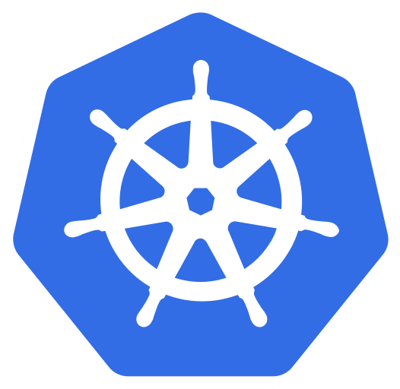


OPENSHIFT PLATFORM
Multinetwork with Multus
Kubernetes
Multus CNI
CNI
CRDs
The Multus CNI “meta plugin” for Kubernetes enables one to create multiple network interfaces per pod, and assign a CNI plugin to each interface created.
OpenShift
SDN CNI
eth0
pod
Additional networks and capability
CNI
net0
CNI
net1
...
Notes:
Multus Enables Multiple Networks & New Functionality to Existing Networking
The Multus CNI “meta plugin” for Kubernetes enables one to create multiple network interfaces per pod, and assign a CNI plugin to each interface created.
Create pod annotation(s) to call out a list of intended network attachments...
...each pointing to CNI network configurations packed inside CRD objects
Multus allows pods to have multiple network interface connections that can address various use cases; for example:
Splitting the control/data plane traffic, mostly applicable to vnf/cnf applications
Legacy/storage intensive applications
Multitenant networks

Slide 39
Additional OpenShift-Supported Secondary CNI Plug-Ins
OPENSHIFT PLATFORM
OpenShift 4.x Tested Integrations: Network Components and Plugins
host device
IPAM(dhcp)
MACVLAN
IPVLAN
Bridge with VLAN
Static IPAM
DHCP IPAM
Route Override
whereabouts
SR-IOV
...
Notes:
Initial ARM support targets nVidia/Mellanox collaboration for BlueField-2 DPU.

Slide 40

OPENSHIFT PLATFORM
Pod with Multiple nics
annotations:
k8s.v1.cni.cncf.io/networks: |-
[
{
"name": "net-test",
"namespace": "test",
"default-route": ["10.10.10.254"]
}
]
eth0
primary
pod
SR-IOV
net0
Multus
Notes:
OCP 4 includes the capability to use SR-IOV hardware on nodes, which enables you to attach SR-IOV virtual function (VF) interfaces to Pods in addition to other network interfaces.
Two components are required to provide this capability: the SR-IOV network device plug-in and the SR-IOV CNI plug-in:
The SR-IOV network device plug-in is a Kubernetes device plug-in for discovering, advertising, and allocating SR-IOV network virtual function (VF) resources. Device plug-ins are used in Kubernetes to enable the use of limited resources, typically in physical devices. Device plug-ins give the Kubernetes scheduler awareness of which resources are exhausted, allowing Pods to be scheduled to worker nodes that have sufficient resources available.
The SR-IOV CNI plug-in plumbs VF interfaces allocated from the SR-IOV device plug-in directly into a Pod.
Further detailed information on the very specific NIC models that we are initially targeting for SR-IOV implementation:
* Intel XXV710-DA2 25G card with vendor ID 0x8086 and device ID 0x158b
* Mellanox MT27710 Family [ConnectX-4 Lx] 25G card with vendor ID 0x15b3 and device ID 0x1015
* Mellanox MT27800 Family [ConnectX-5] 100G card with vendor ID 0x15b3 and device ID 0x1017
(See also: https://github.com/openshift/openshift-docs/pull/14563/files#diff-56052e748d888ef434f910606f960260R32)
We will add more NICs in future releases.

Slide 41




OPENSHIFT PLATFORM
High-performance multicast
eth0
primary
pod
SR-IOV
net0
Multus
Notes:
Achive high performance by attaching an SR-IOV device to your pod as a second network interface

Slide 42
Have Fun !!!
Red Hat is the world’s leading provider of enterprise open source software solutions. Award-winning support, training, and consulting services make Red Hat a trusted adviser to the Fortune 500.

